Slide 1
Games & Adversarial Search
Chapter 6
Section 1 – 4

Slide 2
Games vs. search problems
"Unpredictable" opponent → specifying a move for every possible opponent’s reply.
Time limits → unlikely to find goal, one must approximate

Slide 3

Game tree (2-player, deterministic, turns)
How do we search this tree to find the optimal move?

Slide 4

Minimax
Idea: choose a move to a position with the highest minimax value = best achievable payoff against a rational opponent.
Example: deterministic 2-ply game:
minimax value
Minimax value is computed
bottom up:
-Leaf values are given.
-3 is the best outcome
for MIN in this branch.
-3 is the best outcome
for MAX in this game.
-We explore this tree in
depth-first manner.

Slide 5
Properties of minimax
Complete? Yes (if tree is finite)
Optimal? Yes (against an rational opponent)
Time complexity? O(b^{m})
Space complexity? O(bm) (depth-first exploration)
For chess, b ≈ 35, m ≈100 for "reasonable" games
→ exact solution completely infeasible

Slide 6
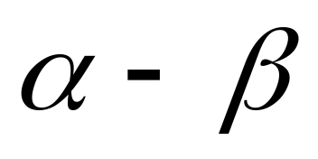
Pruning
Do we need to expand all nodes?
2. No: We can do better by pruning branches that will not lead to success.

Slide 7

α-β pruning example
MAX knows that it can at least
get “3” by playing this branch
MIN will choose “3”, because it minimizes the
utility (which is good for MIN)

Slide 8

α-β pruning example
MAX knows that the new branch
will never be better than 2 for him.
He can ignore it.
MIN can certainly do as good as
2, but maybe better (= smaller)

Slide 9

α-β pruning example
MIN will do at least as good as 14 in this branch
(which is very good for MAX!) so MAX will want
to explore this branch more.

Slide 10

α-β pruning example
MIN will do at least as good as 5 in this branch
(which is still good for MAX) so MAX will want
to explore this branch more.

Slide 11

α-β pruning example
Bummer (for MAX): MIN will be able
to play this last branch and get 2. This
is worse than 3, so MAX will play 3.

Slide 12
Properties of α-β
Pruning does not affect final result (it is exact).
Good move ordering improves effectiveness of pruning
(see last branch in example)
With "perfect ordering," time complexity = O(b^{m/2})
  → doubles depth of search

Slide 13
The Algorithm
Visit the nodes in a depth-first manner
Maintain bounds on nodes.
A bound may change if one of its children obtains a unique value.
A bound becomes a unique value when all its children have been checked or pruned.
When a bound changes into a tighter bound or a unique value, it may become inconsistent with its parent.
When an inconsistency occurs, prune the sub-tree by cutting the edge between the inconsistent bounds/values.
→ This is like propagating changes bottom-up in the tree.

Slide 14
Try it yourself
-which nodes can be pruned?
-always try going right before going left.
-maintain bounds!
5
6
3
4
1
2
7
8

Slide 15
Practical Implementation
How do we make this practical?
Standard approach:
cutoff test: (where do we stop descending the tree)
  depth limit
  better: iterative deepening
  cutoff only when no big changes are expected to occur next (quiescence search).
evaluation function
  When the search is cut off, we evaluate the current state
  by estimating its utility. This estimate if captured by the
  evaluation function.

Slide 16
Evaluation functions
For chess, typically linear weighted sum of features
Eval(s) = w₁ f₁(s) + w₂ f₂(s) + … + w_{n} f_{n}(s)
e.g., w₁ = 9 with
f₁(s) = (number of white queens) – (number of black queens), etc.

Slide 17
Deterministic games in practice
Checkers: Chinook ended 40-year-reign of human world champion Marion Tinsley in 1994.
Chess: Deep Blue defeated human world champion Garry Kasparov in a six-game match in 1997.
Othello: human champions refuse to compete against computers: they are too good.
Go: human champions refuse to compete against computers: they
are too bad.

Slide 18
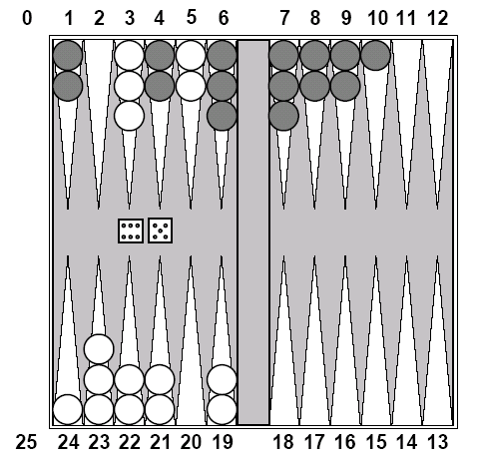
Chance Games.
Backgammon
your element of
chance

Slide 19
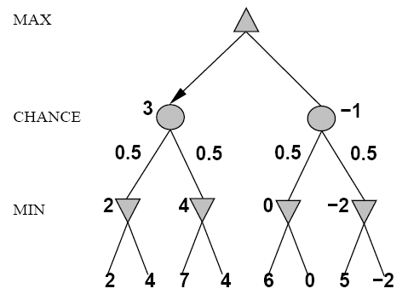
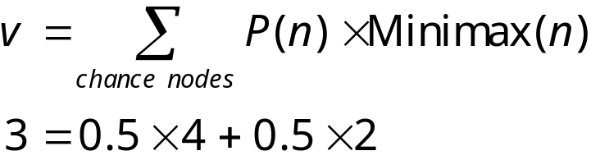
Expected Minimax
Again, the tree is constructed
bottom-up.
Now we have even more nodes
to search!

Slide 20
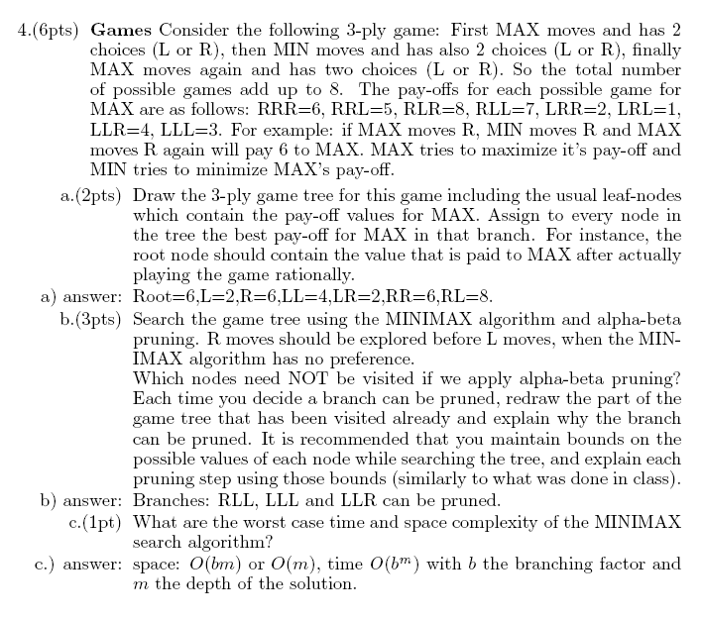

Slide 24
Summary
Games are fun to work on!
We search to find optimal strategy
perfection is unattainable → approximate
Chance makes games even harder

